Slide 1

Immersive Technology Development
Lesson 8:
Virtual Reality
Elyas Chua-Aziz
cel9@np.edu.sg
Diploma in IM
October 2021

Slide 2
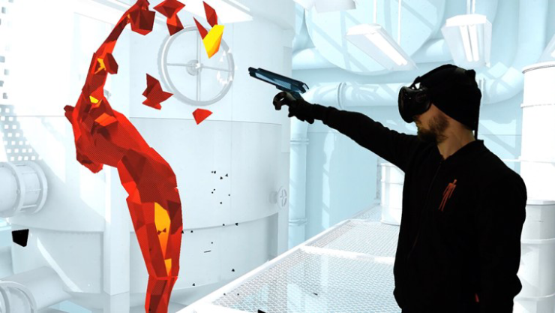
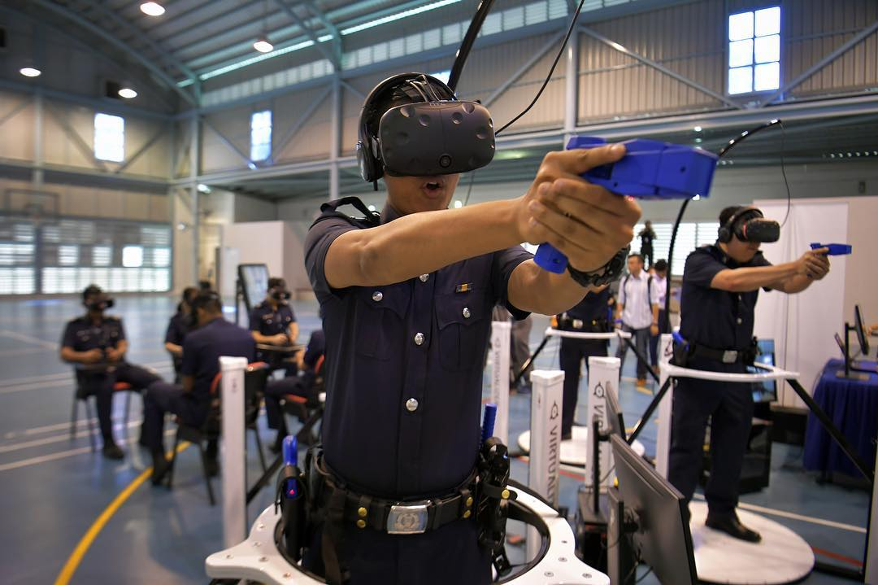
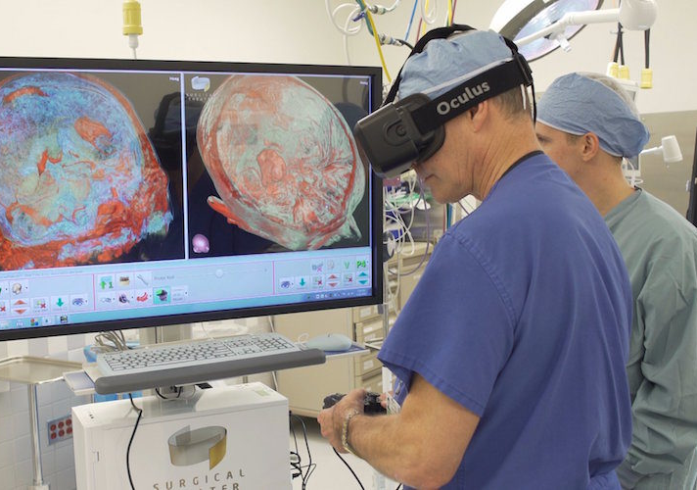
Virtual Reality
Virtual Reality (VR) refers to using technology to create virtual environments and placing users in those environments.
Specialized headsets are worn by users to block out the real world and increase the immersion of the experience.

Slide 3
Why VR?
VR is quickly gaining a foothold in household entertainment and is no longer just a niche field.
This is because the hardware is getting more accessible and portable, and is now more “digestible” to the everyman.
The development process for VR apps is also becoming more streamlined, making it a good time to enter the industry.

Slide 4
Lesson Objectives
Form groups for Assignment 2.
Set up Unity with XRTK.
Use XRTK Simulator to create basic VR interactions.

Slide 5
Assignment 2 Groups
Assignment 2 will be done in groups, and the size allocation for each class is as follows:
M01: 5, 5, 6, 6 (2 groups of 5, 2 groups of 6)
M02: 5, 5, 5, 5 (4 groups of 5)
M03: 5, 5, 4 (2 groups of 5, 1 group of 4)
Group sizes are larger this time around because of the hardware limitations.
Take a few minutes to form and sit in your groups.

Slide 6
Virtual Reality
To create a VR experience, we need to have a project that can communicate with VR headsets.
In order to do that, we will have to install the XRTK plugin to Unity.
XRTK stands for Extended Reality Toolkit.
This toolkit will give Unity the necessary tools to communicate with a VR headset, which lets us create our VR project.

Slide 7
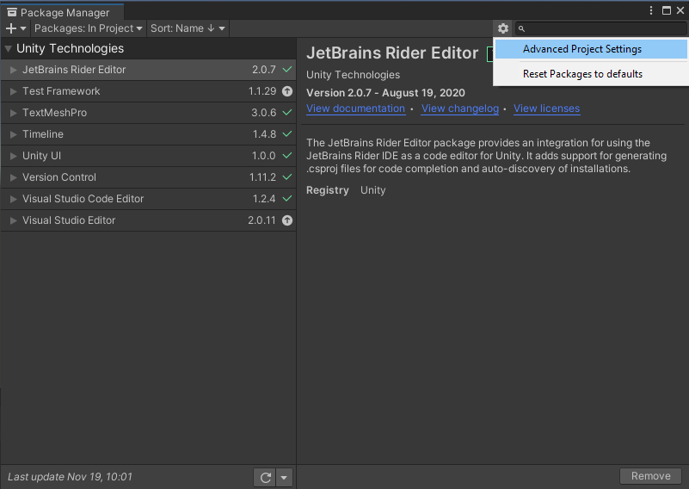
Setting up Unity
Create a new 3D Unity Project.
Navigate to the Package Manager window.
Click on the gear icon and access Advanced settings.
The Project Settings window will appear.

Slide 8
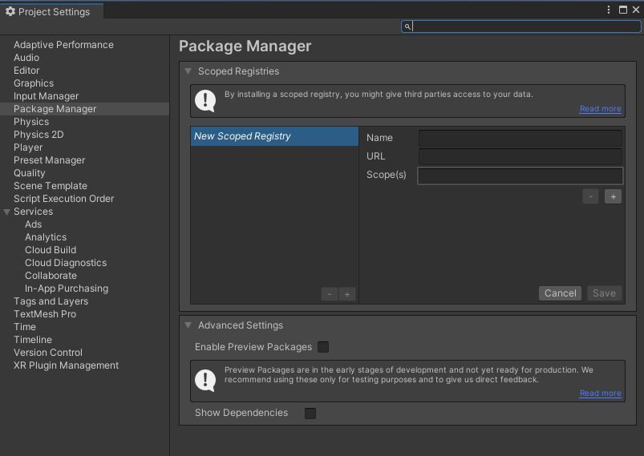

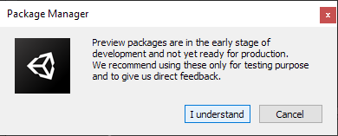
Setting up Unity
In the Project Settings window, make sure you’re at the Package Manager page.
Look for the ‘Enable Preview Packages’ option.
Toggle the checkbox to enable preview packages.
Click ‘I understand’ in the pop up window.
Go back to the Package Manager window

Slide 9
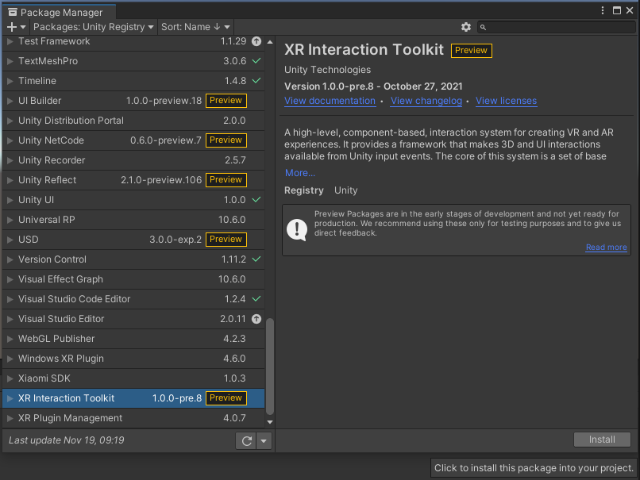
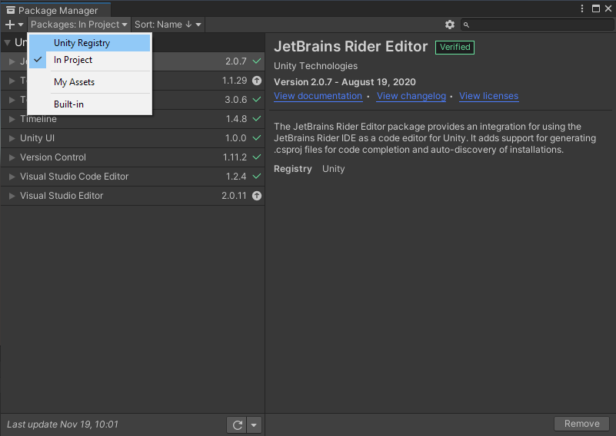
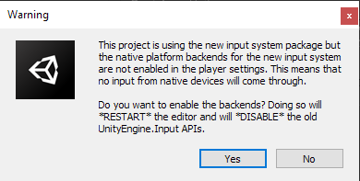
Setting up Unity
Select Unity Registry as the source of Packages.
You will see new Preview Packages being listed.
Look for XR Interaction Toolkit.
Select it and click ‘Install’
Click on ‘Yes’ in the Warning window.
Unity should close and restart.

Slide 10
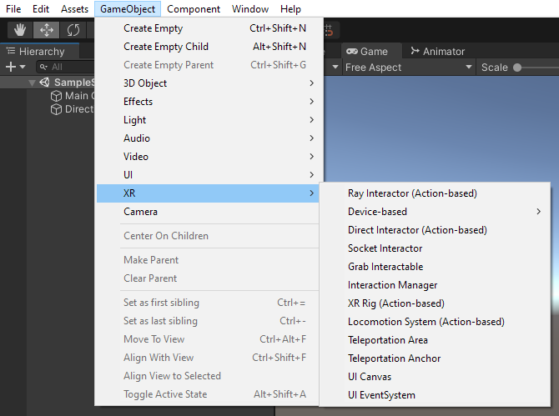
Setting up Unity
Let’s check if the XRTK Package has been installed successfully.
Click on the ‘GameObject’ option on the toolbar.
Look for the ‘XR’ option and see if you have the XR gameobjects available to create.

Slide 11
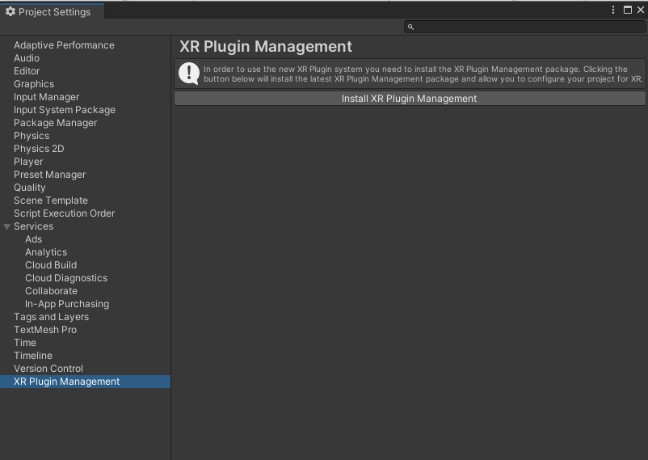
Setting up Unity
Once the XRTK Package is installed successfully, we need to set our project to be an XR project.
To do so, go to the Project Settings window.
Look for the ‘XR Plugin Management’ page and click Install.

Slide 12
Demo Time!

Slide 13
Basics of VR Development
Developing a VR experience will rely heavily on the physics system of Unity.
Mechanics of a VR experience typically include:
Picking up & putting down things
Moving objects by grabbing them
Interacting with objects
XRTK gives us the ability to implement these mechanics with its Interactors and Interactables system.
Interactables will refer to objects in our scene that can be picked up, pressed, moved, etc.
Interactors will refer to what picks up/presses/moves those objects.
Usually our hands/controllers

Slide 14
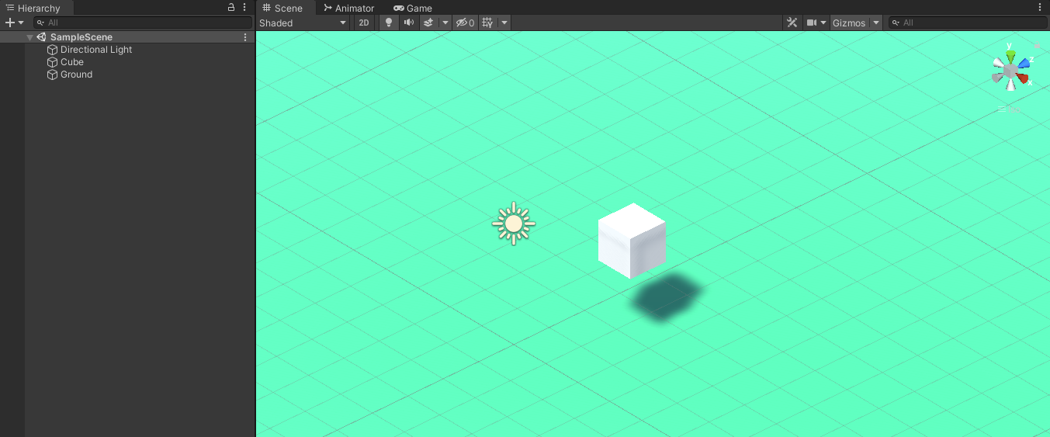
Setting up a VR Project
In a new scene, first add a plane that will act as the ground for your VR experience.
Then create a cube object, and add a Rigidibody component to it.
We will be trying to grab and move this cube later.
The default Camera can be deleted as well.

Slide 15
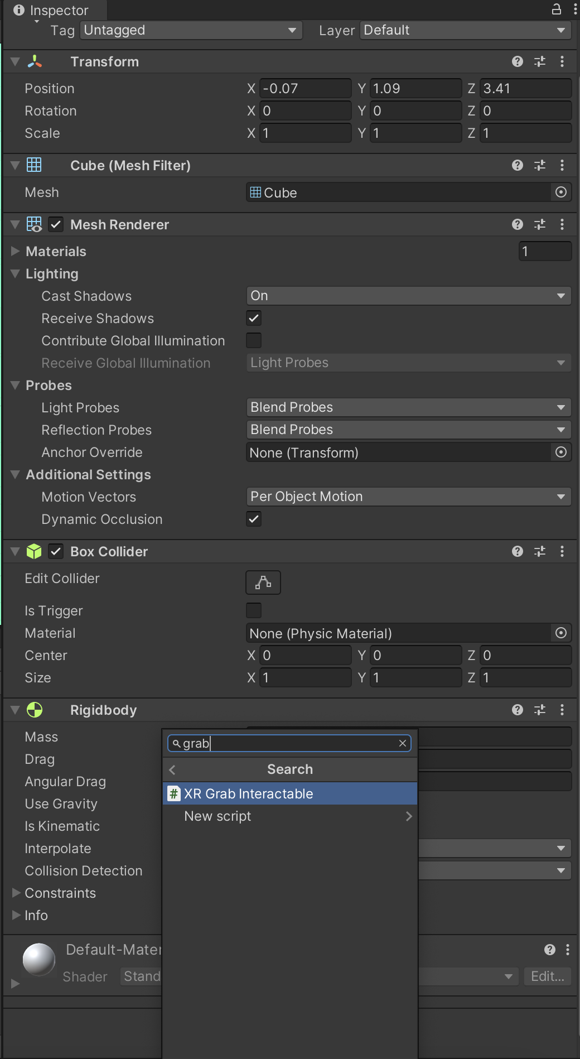
Setting up a VR Project
Now that we have a basic cube in the scene, we can start to make it an Interactable.
To do so, select the cube and go to its Inspector window.
Click ‘Add Component’ and look for the component called ‘XR Grab Interactable’. Select it once it is found.
This is a component provided by XRTK that marks whatever GameObject it is on as something that can be grabbed by a user.

Slide 16
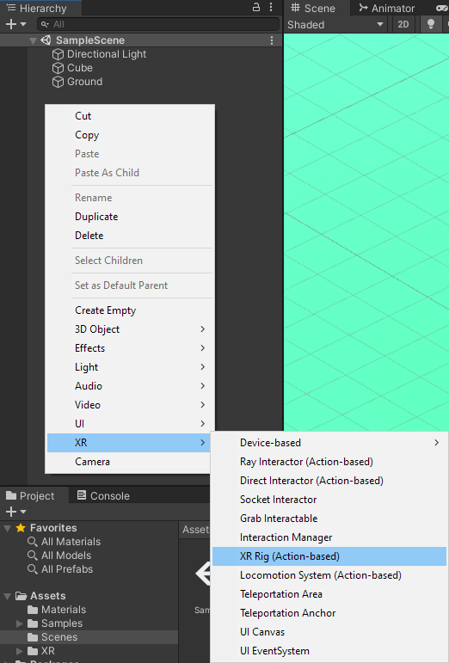
Setting up a VR Project
In the Hierarchy window, right click and select XR > XR Rig (Action-based).
This adds 2 objects in your scene:
XR Rig
XR Interaction Manager
The XR Rig is a default set-up from XRTK that our users will use to interact with objects.
It comes with 2 Interactors (our controllers) that we can use to act on Interactables.
The XR Interaction Manager handles the interactions between Interactor and Interactable.
This object is absolutely necessary and must be in the scene for your interactions to work.

Slide 17
Demo Time!

Slide 18
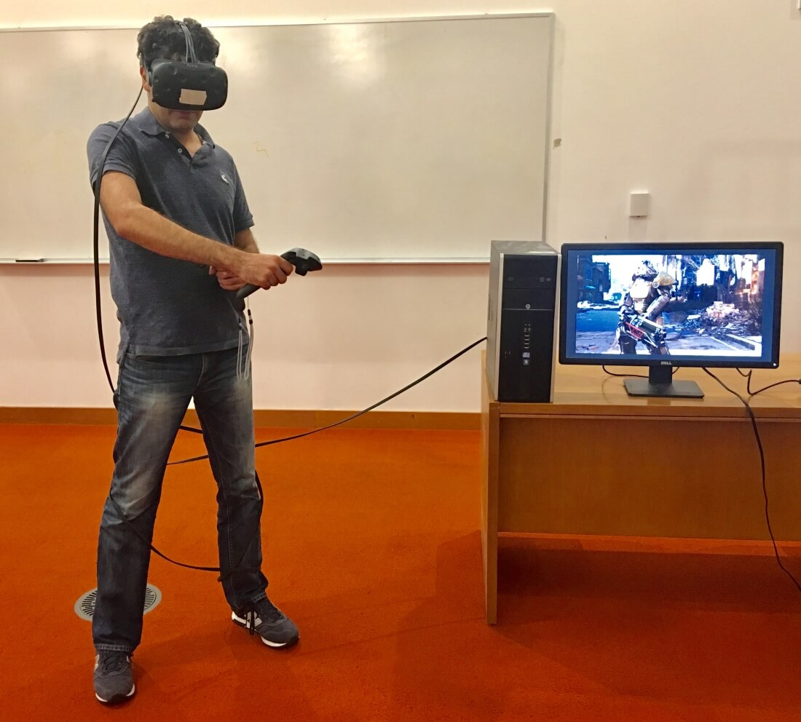
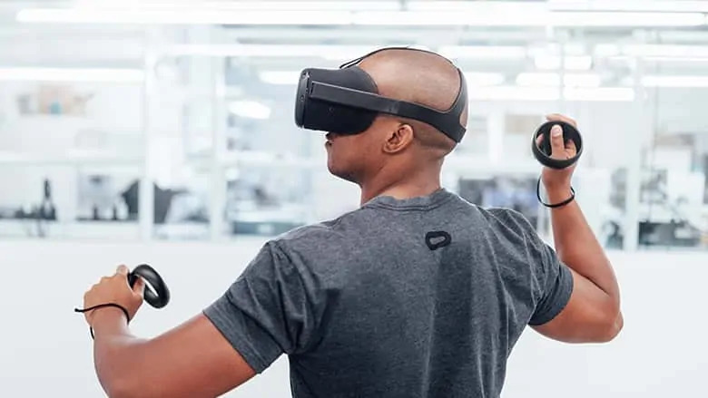
Types of VR Headset
There are 2 broad types of VR headsets available now.
Tethered
Untethered

Slide 19
Tethered Headsets
Tethered headsets must be connected to a computer to be used.
In this way, the computer usually handles the backend work and leaves the headset to only display graphics.
This generally results in tethered headsets being able to run higher end applications (with more intense graphics, effects, physics, etc.) with lesser lag.
This is because the connected computer will handle most of the calculations and workload.

Slide 20
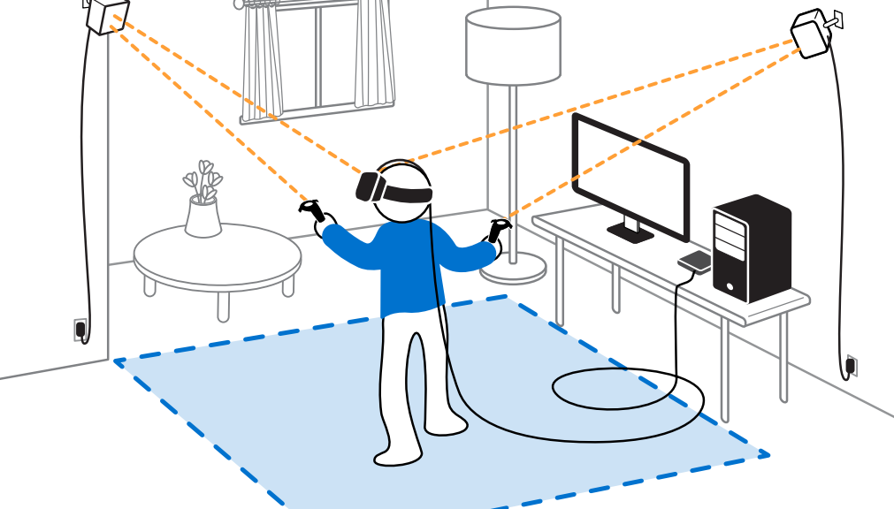
Tethered Headsets
However, that is one of the main cons of tethered headsets.
More cost (because of the computer) to run a VR experience.
Tethered headsets also typically come with additional hardware called base stations.
These base stations are used to track the position of the user in the real world.
This means more physical space is needed.

Slide 21
Untethered Headsets
Untethered headsets are standalone, and do not need a computer to be connected to run.
This means that the headsets will handle all the work when running a VR application.
An untethered headset also saves on space and cost because no additional hardware is needed to work.

Slide 22
Untethered Headsets
Because an untethered headset will handle all the work, it also means that it will not be able to handle more intense applications.
This is partly due to ergonomics. Untethered headsets must be lightweight enough that users do not get fatigued when using them.
For it to be lightweight and compact, the hardware used must be much smaller and thus not as powerful.
Untethered headsets run on battery power and need to be charged regularly so that it does not run out of power while in use.
Battery issues (e.g. leaks, short lifespan) might also surface in the long run.

Slide 23
Available Headsets
For this assignment, the school has both kinds of headsets available for loan.
The headsets available are:
Untethered: Oculus Quest
Tethered: Samsung Odyssey+
However, both headsets will not be able to be used with Mac devices.
A workaround would be to install Windows OS using bootcamp.

Slide 24
5 People, 1 Headset?
Because of the physical limitations, not every group member will have the chance to work with the headset.
This makes it hard to test features that are developed by a member who does not have the headset.
No, this does not mean that the headset carrier tanks the whole project.
In order to test VR features without a VR headset, we can use the XRTK Device Simulator.

Slide 25
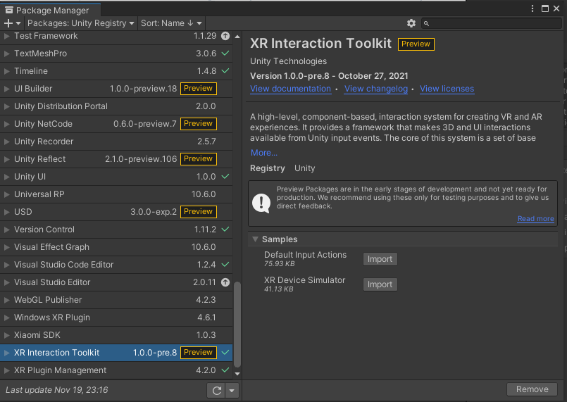
Setting up XRTK Simulator
To use the Simulator Rig, we must first set up the Input Actions that it needs.
Look for ‘XR Interaction Toolkit’ in the Package Manager.
Expand the ‘Samples’ option, then import the ‘Default Input Actions’
Once the import is complete, we can set up our Input Actions.

Slide 26
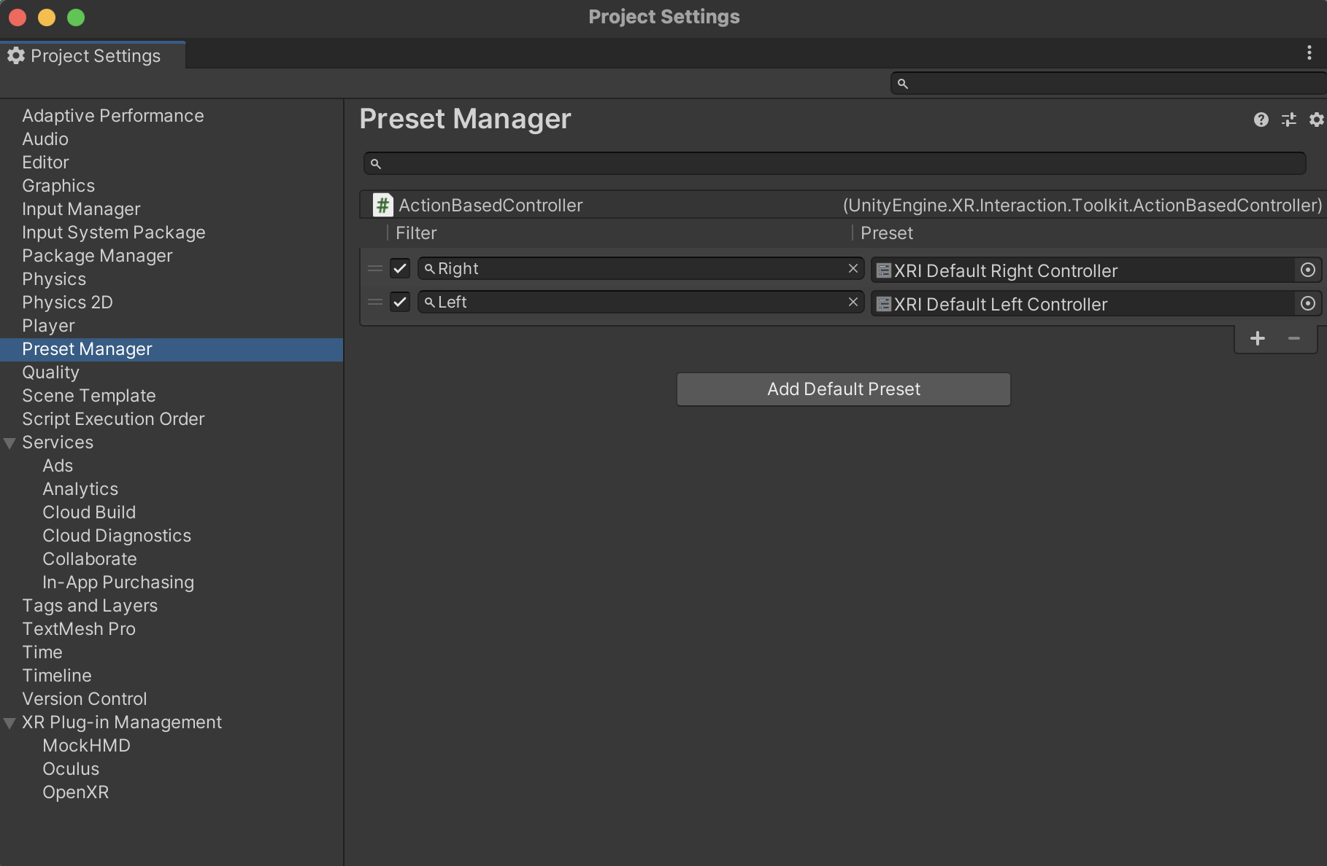
Setting up XRTK Simulator
Go back to your Project Settings window, and navigate to Preset Manager
You should two new presets labeled “XRI Default Right/Left Controller”
Add “Right” and ”Left” as the filters for each preset.

Slide 27
Setting up XRTK Simulator
What the ”Default Input Actions” package does is link certain VR actions (e.g. grabbing, triggering, moving, etc.) to traditional mouse and keyboard input (instead of the VR headset & controllers).
By importing it into our project, we can link the XR Rig to our keyboard and mouse and control it in that way.
However, Unity requires us to delete the existing XR Rig and XR Input Manager and recreate them.

Slide 28
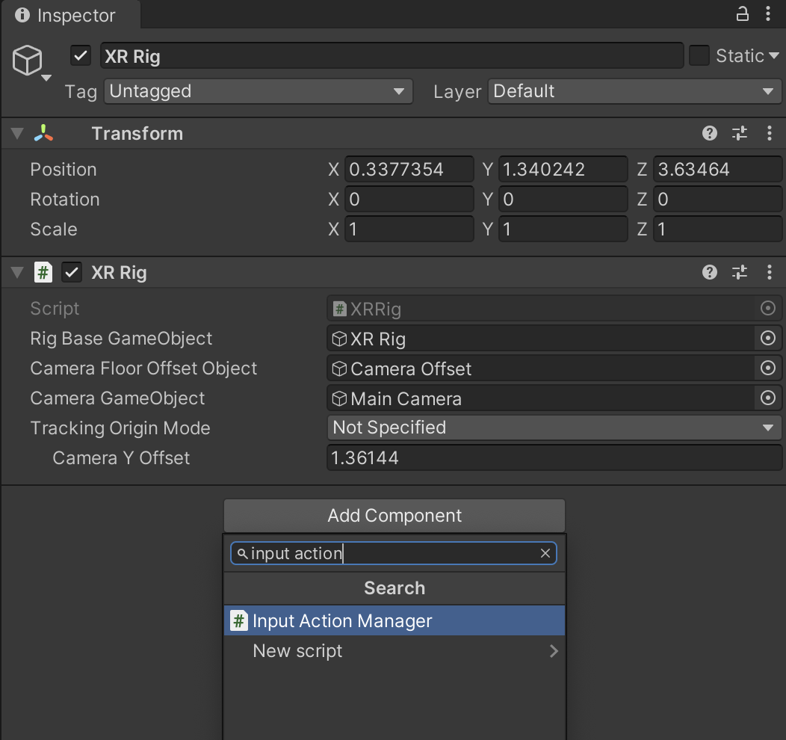
Setting up XRTK Simulator
After recreating the XR Rig and XR Interaction Manager objects, select the XR Rig object.
Go to its Inspector window and click Add Component.
Search for “Input Action Manager”, and select it.

Slide 29
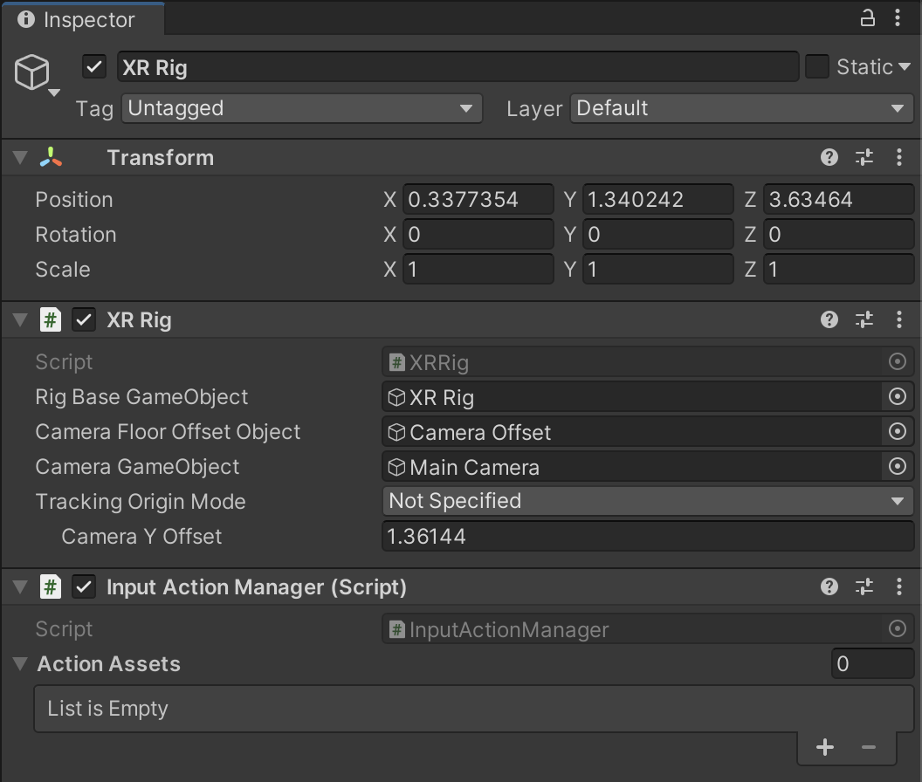
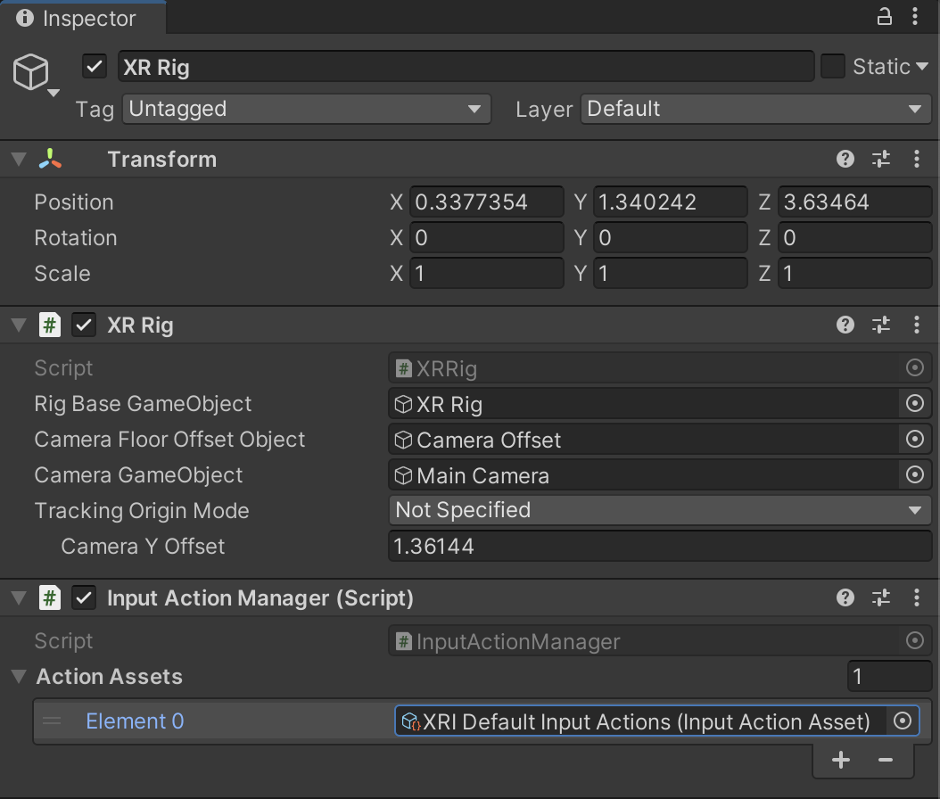
Setting up XRTK Simulator
After the component is added, you will notice a variable named “Action Assets”.
Click on the ‘+’ icon, and look for “XRI Default Input Actions”.

Slide 30
Setting up XRTK Simulator
After setting up Input Actions, we need to import the ‘XR Device Simulator’ package.
The device simulator will read the input from our keyboard and mouse, and tell the XR Rig what to do.

Slide 31
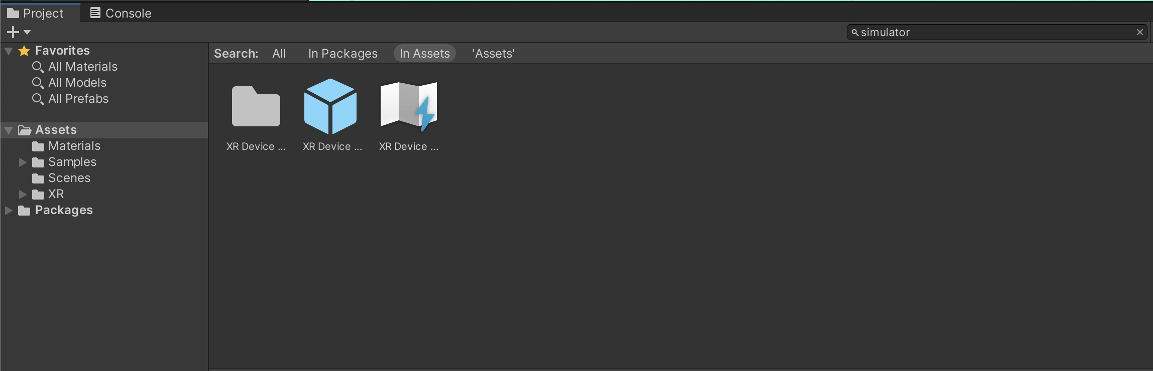
Setting up XRTK Simulator
Once the import is completed, go to the Project window and look for a prefab named “XR Device Simulator”.
Drag this prefab into your scene.
You will be able to control the XR Rig now with your keyboard and mouse on pressing Play.

Slide 32
Demo Time!

Slide 33
Controlling the XRTK Simulator
Controlling the Camera:
Moving along X and Y:
Click and drag right mouse button
Moving along Z:
Scroll up/down
Controlling the Hands:
Moving along the X and Y:
Hold shift(left hand)/spacebar(right hand) and move the mouse.
Moving along Z:
Hold shift(left hand)/spacebar(right hand) and scroll the mousewheel.
Rotating the ‘Hand’:
Hold shift(left hand)/spacebar(right hand) and move the mouse while holding the mousewheel.
Grabbing an object:
Press and hold G while the Interactor Ray intersects the Interactable.

Slide 34
Summary
We can create VR experiences in Unity with the help of the XRTK package.
The XRTK Package gives us Interactors (e.g. XR Rig), and Interactables (e.g. Grab Interactable) that allows us to build simple VR Interactions.
XRTK also provides a XR Device Simulator that allows us to test features without the use of a VR Headset.

Slide 35
Moving forward
Discuss within your groups, which VR headset you would like to try.
First come first serve!
Start coming up with some ideas for Assignment 2.
Some guidelines:
The experience should be educational in nature.
There must be some form of assessment to know whether the user has learned what you want them to learn.
The assignment will be combined with DDA. This means that you must use databases in some form to affect the user experience.
E.g. letting users create a profile, then saving what objects are active in the scene.

